Slide 1
A presentation on A* Search
JANNATUL FERDOUS ( 011 131 119)
MD. AFSER ( 011 131 123)

Slide 2
A* SEARCH
A computer algorithm used in path finding and graph traversal.
Extension of Dijkstra's algorithm.
Achieves better performance by using heuristics to guide its search.

Slide 3
ADVATAGE AND DISADVANTAGE
Advantage : always provide optimal solution.
Disadvantage: Memory Requirement.

Slide 4
MECHANISM
Idea: avoid expanding paths that are already expensive
Evaluation function f(n) = g(n) + h(n)
g(n) = cost so far to reach n
h(n) = estimated cost from n to goal
f(n) = estimated total cost of path through n to goal
While extracting a node from fringe queue there will be checking that the node is goal or not. If it is goal then the mechanism ends otherwise the iteration will go on.

Slide 5
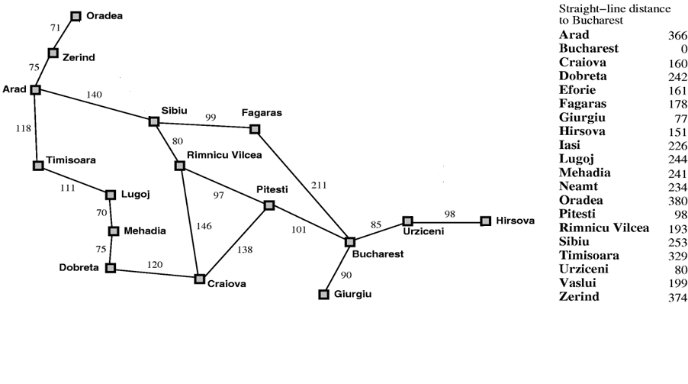
ROMANIA WITH STRAIGHT-LINE DISTANCE

Slide 6
FRINGE QUEUE AND VISITED QUEUE
In Fringe QUEUE the nodes will be set in ascending order according to the total cost to reach goal.
In visited QUEUE the node which is already visited will be in the queue.

Slide 7
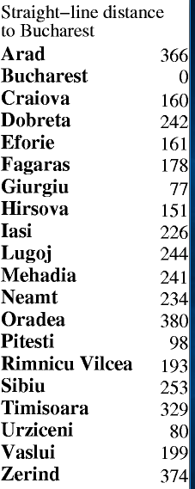
Arad
FRINGE QUEUE
A
VISITED QUEUE

Slide 8
Arad
75
118
Zerind
140
Timisoara
F(n)=75+374=449
Sibiu
F(n)=118+329=447
F(n)=140+253=393
FRINGE QUEUE
S | T | Z
VISITED QUEUE
A
Now according to algorithm SIBIU will expand.

Slide 9
140
SIBIU
80
99
RIMNICU
VILCEA
FAGARAS
F(n)=220+193=413
F(n)=239+178=417
FRINGE QUEUE
RV | F | T | Z
VISITED QUEUE
A | S
Now according to algorithm RIMNICU VILCEA will expand.

Slide 10
220
RIMNICU
VILCEA
146
97
CRAIOVA
PITESTI
F(n)=366+160=526
F(n)=317+98=415
FRINGE QUEUE
P | F | T | Z | C
VISITED QUEUE
A | S | RV
Now according to algorithm PITESTI will expand.

Slide 11
Here GOAL BUCAREST found but in fringe queue there is least cost node. So that node has to be expanded.
317
PITESTI
101
138
BUCAREST
CRAIOVA
F(n)=418+0=418
F(n)=455+160=615
FRINGE QUEUE
F | B | T | Z | C | C
VISITED QUEUE
A | S | RV | P
Now according to algorithm FAGARAS will expand.

Slide 12
239
FAGARAS
Here BUCAREST is repeated.In Fringe QUEUE will take the least cost node In the queue.
211
BUCAREST
F(n)=450+0=450
FRINGE QUEUE
B | T | Z | C
VISITED QUEUE
A | S | RV | P | F
Now according to algorithm the least cost Goal will be the desired goal
Node.

Slide 13
317
PITESTI
SO it is the final Goal.
101
138
BUCAREST
CRAIOVA
F(n)=418+0=418
F(n)=455+160=615
FRINGE QUEUE
A | S | RV | P | F | B | T | Z | B | C | C
VISITED QUEUE
A | S | RV | P
Now according to algorithm FAGARAS will expand.

Slide 14
Arad
75
118
Zerind
140
Timisoara
Sibiu
F(n)=75+374=449
SIBIU
F(n)=118+329=447
80
99
F(n)=140+253=393
RIMNICU
VILCEA
FAGARAS
RIMNICU
VILCEA
F(n)=239+178=417
97
146
F(n)=317+98=415
F(n)=220+193=413
PITESTI
211
CRAIOVA
101
138
BUCAREST
F(n)=366+160=526
FINAL
GOAL
BUCAREST
CRAIOVA
F(n)=450+0=450
F(n)=418+0=418
F(n)=455+160=615

